Slide 1





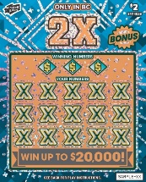
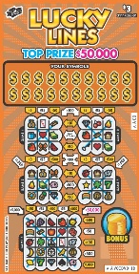

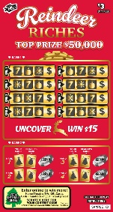
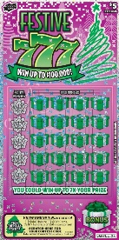


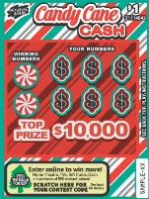
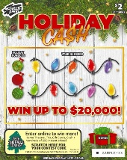



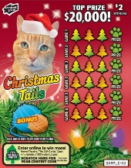
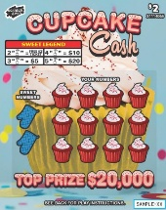


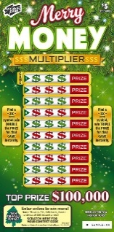
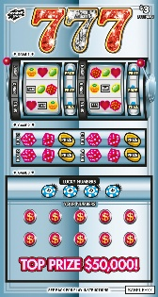





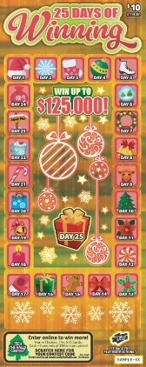

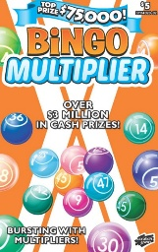

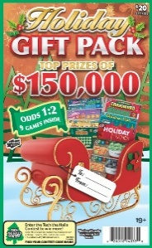
Tickets Expiring September 4, 2026
$₁
$₂
$₃
Rollin In
Riches
31114061
2X
31114058
Lucky
Gems II
31114037
Candy Cane
Cash IV
31114042
Holiday
Cash II
31114047
Lucky
Lines XIV
(Orange)
31114036-01
Shiny and
Bright
31114041
Reindeer
Riches
31114050
777 III
31114054
Scrabble VI
31114055
Super
Crossword
(Yellow/Red)
31114052-01
Winter
Wishes II
31114043
Christmas Tails II
31114048
Cupcake Cash
31114065
$₅
$10
$20
Deluxe
Crossword
(Casino)
31114025-02
Merry
Money
Multiplier IV
31114045
Festive 777
31114045
5X
31114059
High
Roller III
31114064
Set for Life XI
37114040
Bingo
Multiplier VIII
(Orange/Blue)
31114020-02
Luxury
Crossword XX
31114053
Holiday Gift
Pack XII
31114033
25 Days
Of Winning
31114051
10X
31114060
Check the product code in the top right corner of the ticket to ensure it is the correct variation.
Tickets not returned by the expiration date are subject to billing.

